Slide 1


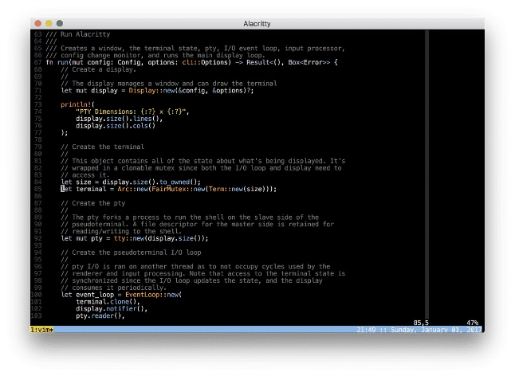
Introduction to Linux Commands for DevOps
Linux commands are essential for DevOps professionals. They allow you to manage systems, automate tasks, and streamline workflows. This presentation will cover a range of Linux commands crucial for DevOps.

Slide 2


Basic Linux Commands
1
ls
2
cd
Lists files and directories in a given directory. Use flags like `-l` for detailed information or `-a` to show hidden files.
Changes the current working directory. Use `cd ..` to move to the parent directory or `cd /` to go to the root directory.
3
pwd
4
mkdir
Prints the current working directory.
Creates a new directory. Use `mkdir -p` to create nested directories.

Slide 3
File Management Commands
Creating and Editing Files
Copying and Moving Files
Deleting Files and Directories
Use `touch` to create a new empty file, `cat` to view file contents, and `nano` or `vim` for text editing.
Use `cp` to copy files and directories. Use `mv` to move files or rename them.
Use `rm` to remove files and `rmdir` to remove empty directories. Use the `-r` flag with `rm` to recursively delete directories.

Slide 4


Process Management Commands
1
ps
Displays running processes. Use flags like `aux` for more detailed information.
2
top
Provides a dynamic view of processes, showing CPU usage, memory consumption, and more.
3
kill
Terminates a process using its process ID (PID). You can specify the signal to send, like `SIGKILL` for immediate termination.

Slide 5

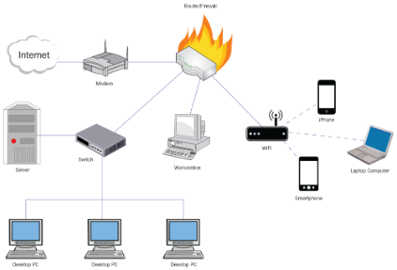




Network Management Commands
ifconfig
ping
netstat
traceroute
Displays network interface configuration information.
Sends ICMP echo requests to a host to test connectivity.
Displays network connections and listening ports.
Tracks the path of network packets to a destination host, identifying routers along the way.

Slide 6

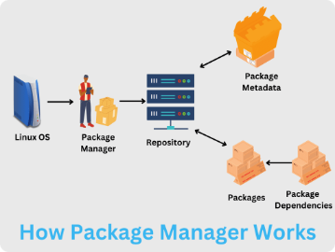
Package Management Commands
apt (Debian-based systems)
yum (Red Hat-based systems)
Use `apt update` to update package lists, `apt install` to install packages, and `apt remove` to uninstall packages.
Use `yum update` to update package lists, `yum install` to install packages, and `yum remove` to uninstall packages.
dnf (Fedora and CentOS 8)
pacman (Arch Linux)
Use `dnf update` to update package lists, `dnf install` to install packages, and `dnf remove` to uninstall packages.
Use `pacman -Syu` to update package lists and install packages, and `pacman -Rs` to uninstall packages.

Slide 7

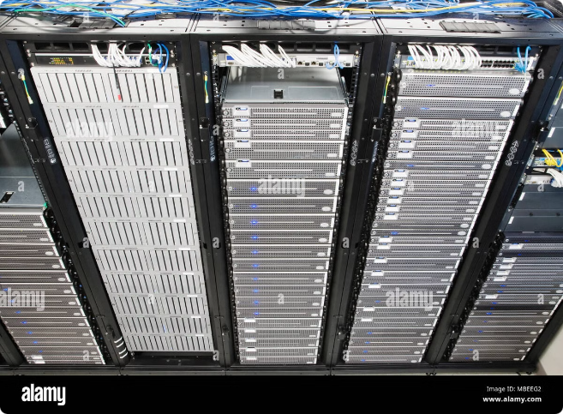
System Administration Commands
Command
Description
date
Displays the current date and time.
cal
Shows the calendar for a specified month or year.
uptime
Shows how long the system has been running.
whoami
Displays the current user's username.
passwd
Changes the user's password.
shutdown
Shuts down the system.
reboot
Restarts the system.

Slide 8

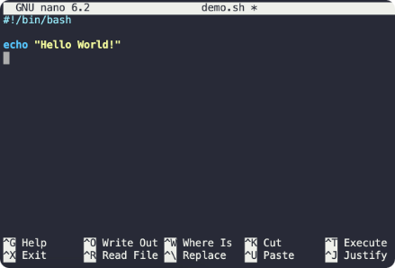



Scripting and Automation Commands
Bash Scripting
Ansible
Python
Write shell scripts to automate repetitive tasks. Bash is a powerful scripting language widely used in Linux.
Ansible is a configuration management and automation tool that simplifies infrastructure provisioning and application deployment.
Python is a versatile scripting language suitable for a wide range of DevOps tasks, including system administration, data analysis, and automation.

